Slide 1
Dart Scoring System Preliminary Design Review
EN.525.743 – Embedded Systems Development Laboratory
Kevin Parlak

Slide 2
Agenda
Project Description
Capabilities & Limitations
Functional Description
Interface Description
Material & Resource Requirements
Development Plan
Risks
References

Slide 3
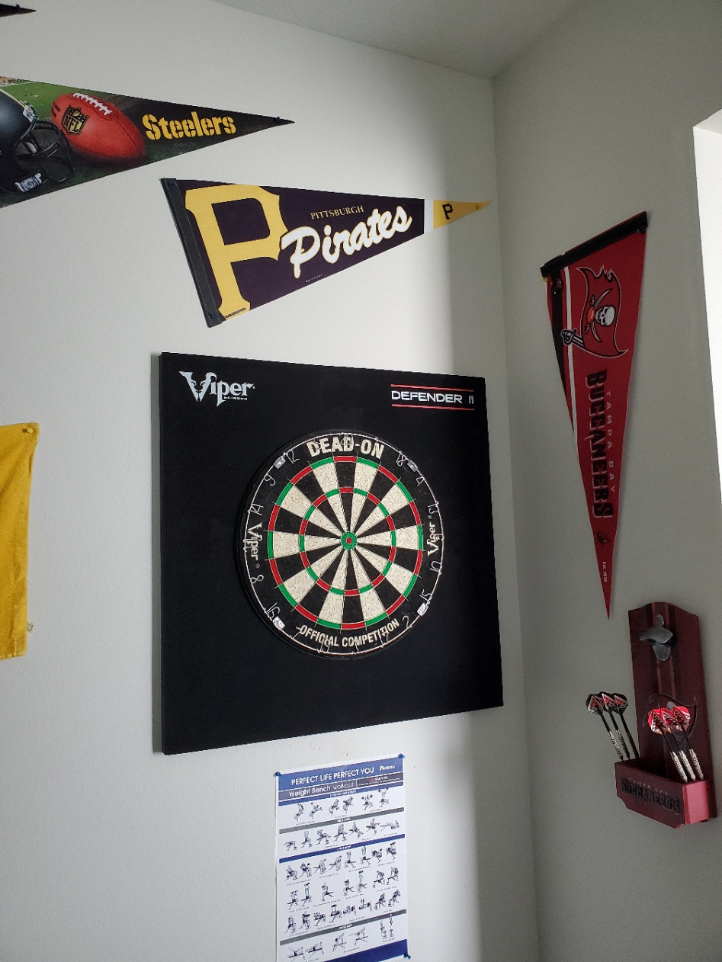
Project Description
Problem: Currently own steel-tipped dart board with no means of keeping score
Solution: Utilize computer vision techniques to track where dart lands and automatically update game score/statistics
Computer vision will find, map, and report dart location
Based on known dataset with training as game is played
User interface will update game scores as dart location is identified
Database will hold score information and be accessible via touchscreen display or mobile device
Bigger Picture:
System will be capable of two games at first – expansion of game selection easy once concept is complete
Machine learning possible based on user data over time – help user get better at playing

Slide 4
Capabilities
Database shall be capable of holding up to 10 players information
User interface shall be capable of displaying dart locations live on a dartboard hit map
Imaging system shall be capable of re-calibrating upon power-up
User interface/mobile app shall be capable of producing statistics from database entries
Hit % by number, win %, double & triple ring, outer & inner bullseye hit %

Slide 5
Limitations
Database shall only be accessible when connected to home network or WAP
Imaging system shall only be capable of tracking a single set of darts at a time
Player to select profile on physical user interface before throwing
System shall only host two games
“501” (score-based), “Around the World” (knockout-based)
System shall only be capable of starting games from the physical user interface
System shall have a two-player limit per game
Database shall only be capable of adding new profiles from physical user interface
Mobile app shall only be usable on Android devices

Slide 6
Functional Description
User will start game, select profile, and choose game to play via touchscreen user interface
Imaging system will begin looking for dart once user profile is selected
Will use identify dart tip location, map to dartboard, and send to scoring system
Scoring system will receive update and calculate statistics and score
Will upload to database and update live hit map for viewing on user interface and mobile device
System will repeat until winner is declared or game is ended
Mobile app will show user statistics and scores

Slide 7
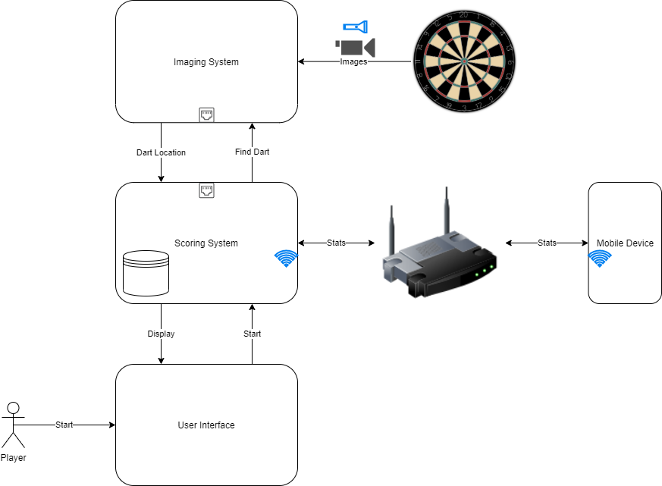
Functional Description – Block Diagram

Slide 8
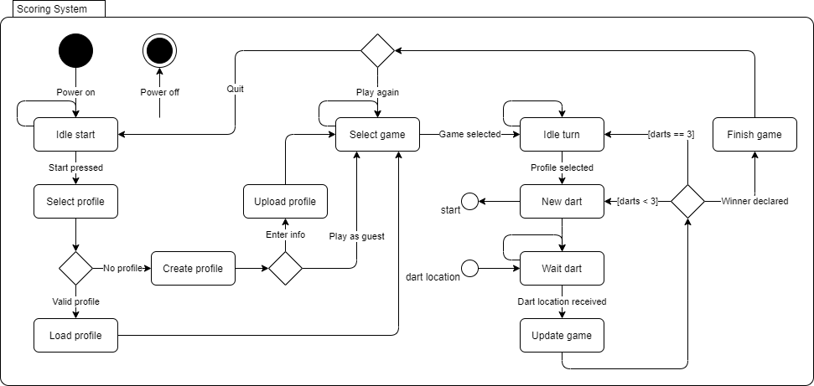
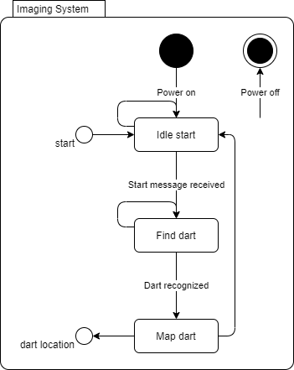
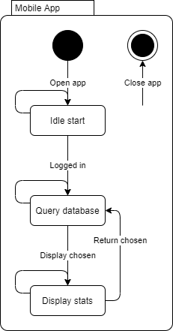
Functional Description – State Machines
Scoring and imaging state machines dependent on each other

Slide 9
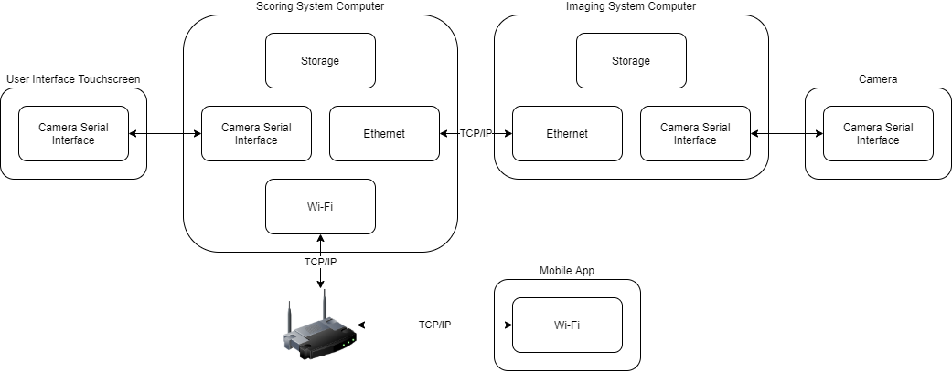
Interface Description – Block Diagram

Slide 10
Interface Description – Communication
Camera Serial Interface
Touchscreen interaction – driver-free
Image acquisition – Python libraries for video streaming
TCP/IP Protocol
Python libraries for socket programming
Scoring system to imaging system communication
Database querying and communication with mobile app

Slide 11
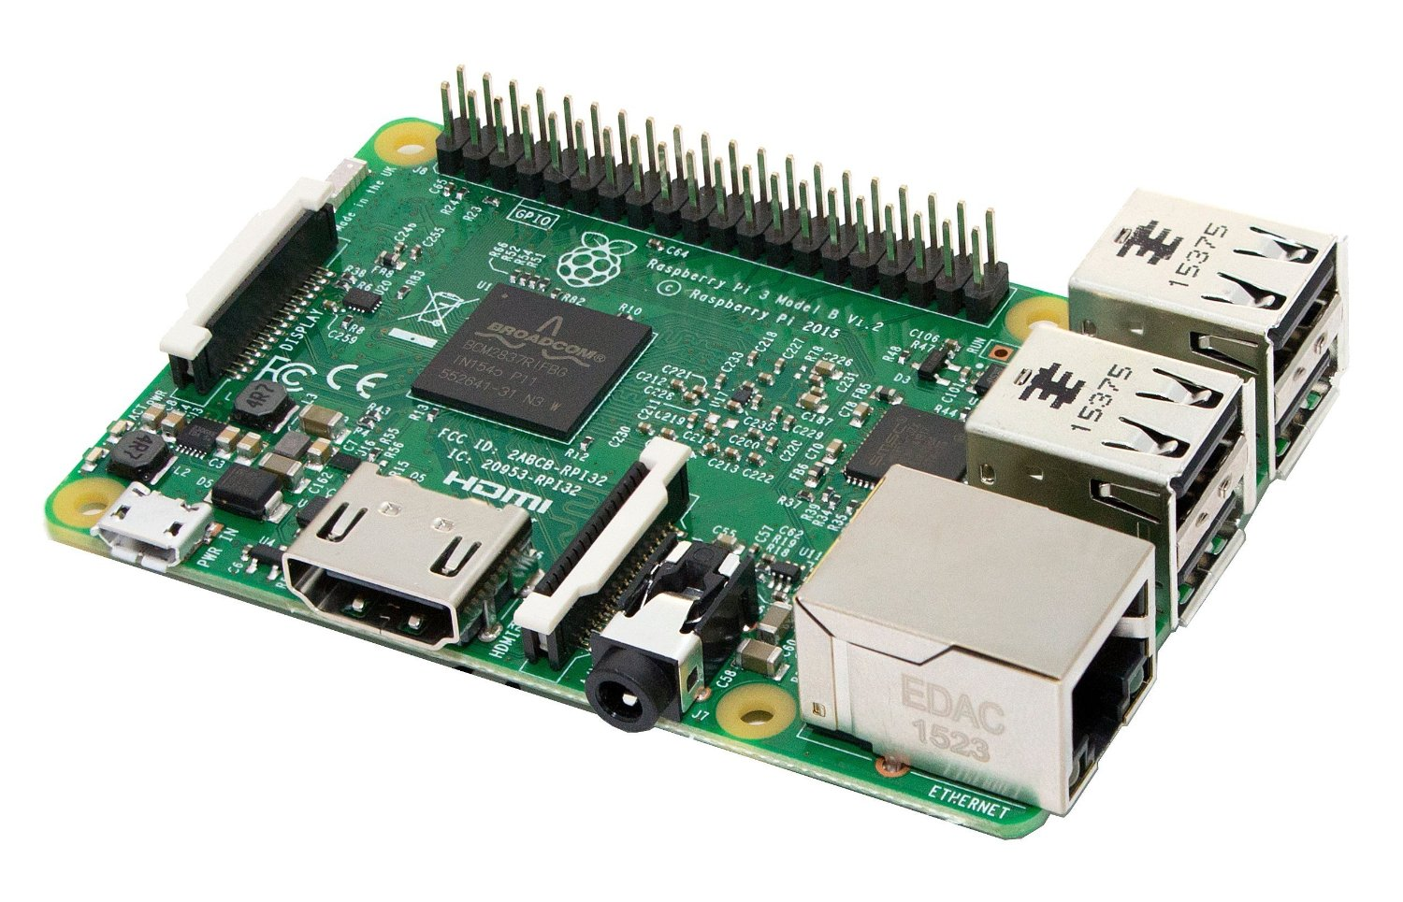
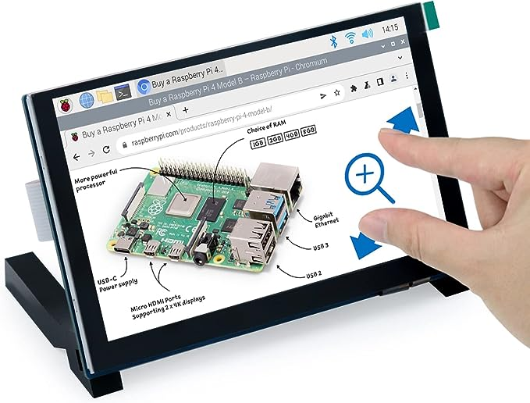
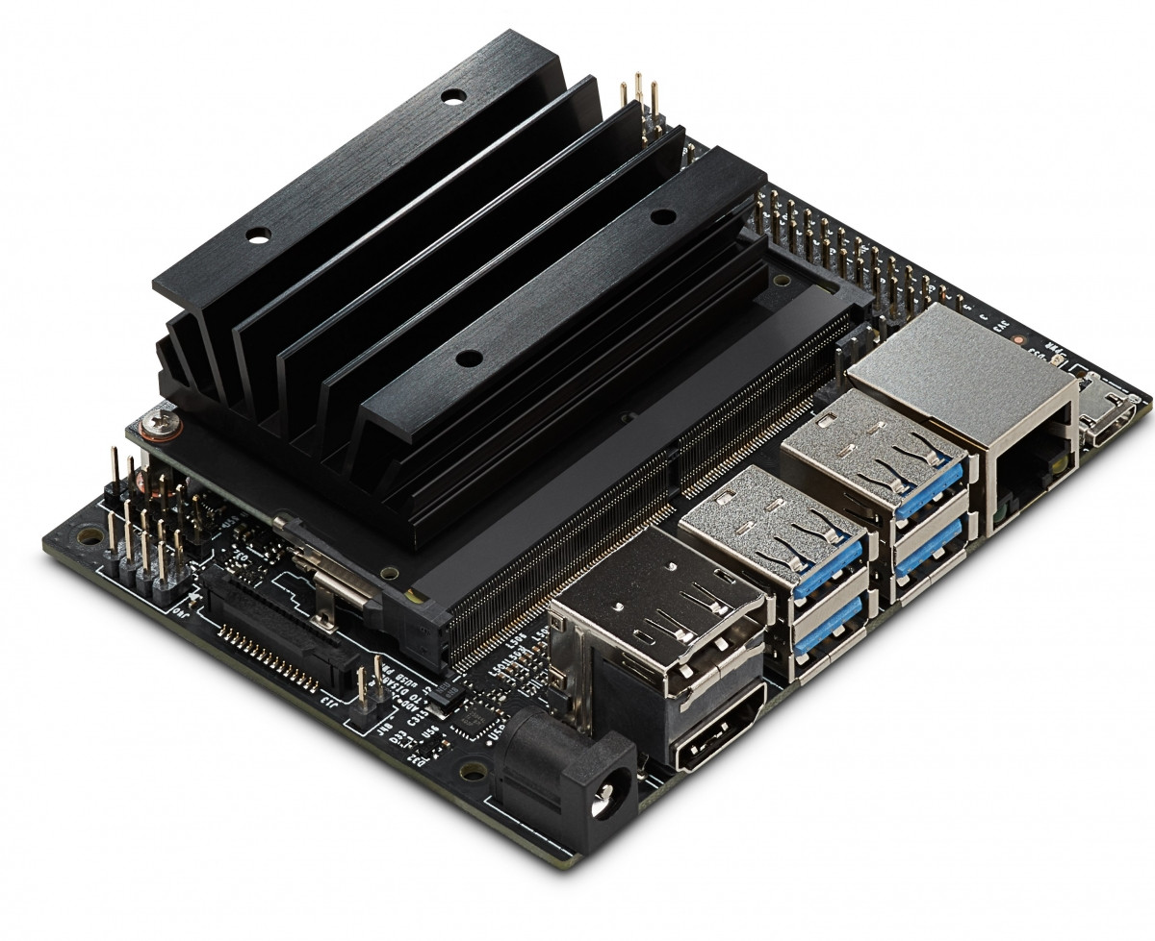
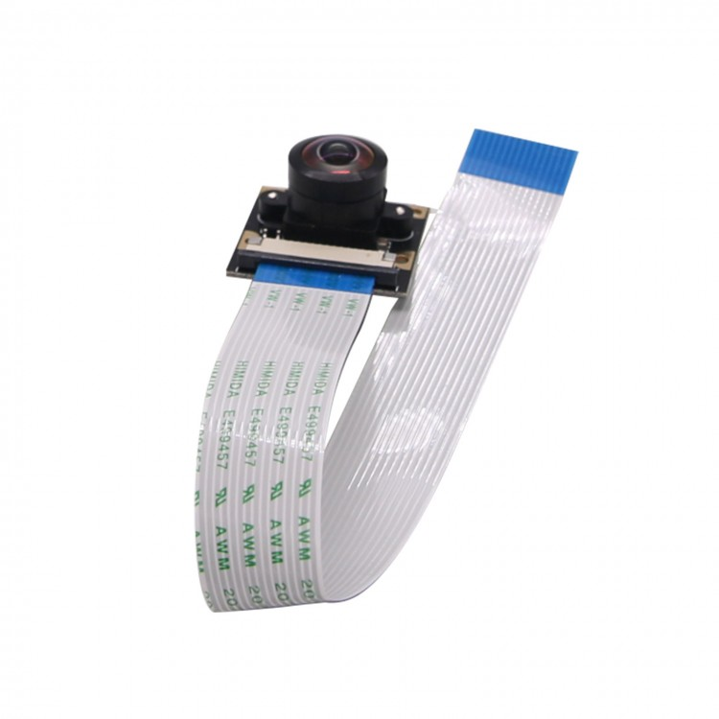
Material Requirements
Scoring System
Raspberry Pi 3B+ with Wi-Fi, Ethernet, and Camera Serial Interface (CSI) connectivity
User Interface
FREENOVE touchscreen monitor for interaction with Pi via CSI
Imaging System
Nvidia Jetson Nano with Ethernet and CSI connectivity
Camera
SainSmart IMX219 8MP module for interaction with Jetson via CSI
Materials readily available and already acquired

Slide 12


Resource Requirements
Development will occur in Python language
Main IDE – VS Code with Python extensions (Python, Pylance, IntelliCode)
Scoring system
Database development – sqllite3 libraries
Wi-Fi communication – SSID connection to home network upon imaging of OS
User interface – driver-free display via CSI; turtle, pyqt5 libraries
Imaging system
Computer vision – opencv-python libraries
Machine learning – tensorflow libraries
Mobile app
Main IDE – Android Studio
Additional tools
Wireshark – packet observation
VNC Viewer – remote Pi access
Existing computer vision dart recognition solutions will be heavily relied on
FOSS software and libraries will be used for core development

Slide 13

Development Plan – Approach
Utilize online repository for issue and progress tracking
https://github.com/kparlak/dart-scoring-system
Get imaging system to produce valid dart positions
Little experience with computer vision/machine learning – flush out early
Get scoring system to run both dart games and communicate with imaging system with basic user interaction
Minimalist approach to produce core of dart scoring system
Create user interface for displaying scores
Minimal experience with GUI development – flush out after core system is functional
Create mobile application
Little experience with mobile apps – flush out after full-cycle system is functional
Tiered approach to alleviate possible blockers

Slide 14
Development Plan – Schedule
Date | Milestone | Progress
9/18 – 10/9 | Dart Recognition Development | Dart recognition Dart location mapping TCP/IP communication
10/9 – 10/23 | Scoring and Game Development | TCP/IP communication ‘501’ and ‘Around the World’ game implementation
10/23 – 10/30 | Database Development | Database creation Database querying
10/30 – 11/13 | User Interface Development | Profile creation Scoreboard implementation Hit map implementation
11/13 – 11/20 | Scoring and Imaging System Integration | Functional system minus mobile app
11/20 – 12/4 | Mobile App Development | Beta Android app deployment Database querying
Milestone based development with tracking in GitHub

Slide 15
Risks
Low
Impact
High
Very Likely
1
Likelihood
2
3
Not Likely
Known Risks
Mitigation
Loss of home internet connectivity
Machine learning for image recognition likely to be difficult
Consistence lighting and angle viewpoints for imaging system
Switch Pi to act as wireless access point rather than Wi-Fi client
Three weeks built-in for imaging system; use known trained datasets from online repositories to feed solution
Implement calibration routines

Slide 16
References
Nvidia Jetson Dart Score Implementation
GitHub OpenCV Steel Darts
Python Libaries

